Slide 1
Trees
this
is
a
tree
Trees
Notes:
Trees

Slide 2
What is a Tree
In computer science, a tree is an abstract model of a hierarchical structure
A tree consists of nodes with a parent-child relationship
Applications:
  Organization charts
  File systems
  Programming environments
Computers”R”Us
Sales
Manufacturing
R&D
US
International
Laptops
Desktops
Europe
Asia
Canada
Trees
Notes:
My note::
A tree is a connected acyclic graph
Leaf: a node whose degree is 1
Trees

Slide 3
What is a Tree
A connected acyclic graph is a tree.
A tree T is a set of nodes in a parent-child relationship with the following properties:
  T has a special node r, called the root of T, with no parent node
  Each node v of T, different from r, has a unique parent node u
A tree cannot be empty, since it must have at least one node – the root.
Trees

Slide 4
Tree Terminology
Root: node without parent (A)
Internal node: node with at least one child (A, B, C, F)
External node (Leaf ): node without children (E, I, J, K, G, H, D)
Ancestors of a node: parent, grandparent, grand-grandparent, etc.
Descendants of a node: child, grandchild, grand-grandchild, etc.
Depth of a node: number of ancestors, excluding the node itself
Height of a tree: maximum depth of any node (3)
Siblings: two nodes that are children of the same parent
Subtree: tree consisting of a node and its descendants
A
subtree
B
C
D
E
F
G
H
I
J
K
Trees

Slide 5
Depth and Height
The depth of a node v can be recursively defined as follows
  If v is the root, then the depth of v is 0.
  Otherwise, the depth of v is one plus the depth of the parent of v
  Algorithm depth(T, v)
  if T.isRoot(v) then
  return 0
  else
  return 1 + depth(T, T.parent(v))
  Running time: O(1 + d_{v}), d_{v} is depth of v in T
  In worst case O(n), n is the number of nodes in T
Trees

Slide 6
Depth and Height
The height of a node v can be recursively defined as follows
  If v is a leaf node, then the height of v is 0.
  Otherwise, the height of v is one plus the maximum height of a child of v
The height of a tree T is the height of the root of T
The height of a tree T is equal to the maximum depth of a leaf node of T
Trees

Slide 7
Depth and Height
  Algorithm height1(T)
  h = 0
  for each v εT.positions(v) do
  if T.isExternal(v) then
  h = max(h, depth(T, v))
  return h
  Running time: O(n + Σ_{v ε E} (1 + d_{v})), where d_{v} is depth of v in T, E is the set of leaves in T
  In worst case O(n²), n is the number of nodes in T
Trees

Slide 8
Depth and Height
  Algorithm height2(T, v)
  if T.isExternal(v) then
  return 0
  else
  h = 0
  for each w ε T.children(v) do
  h = max(h, height2(T, w))
  return 1 + h
  Running time: O(Σ_{v ε T} (1 + c_{v})), where c_{v} is the number of children of v in T
  Since Σ_{v ε T} c_{v =} n - 1, we have O(Σ_{v ε T} (1 + c_{v})) = O(n).
The height of tree T is obtained by calling height2(T, r).
Trees

Slide 9
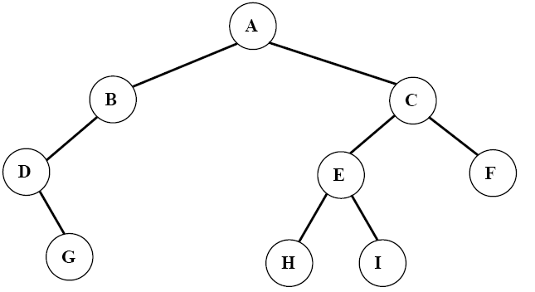
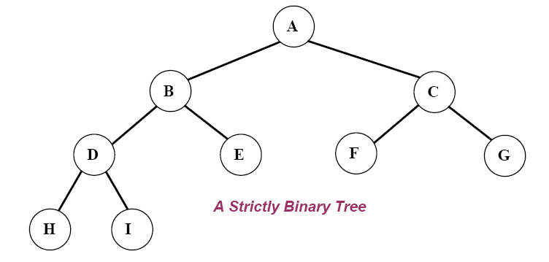
Ordered Trees
A tree is ordered if there is a linear ordering defined for each child of each node.
A binary tree is an ordered tree in which every node has at most two children.
If each node of a tree has either zero or two children, the tree is called a proper (strictly) binary tree.
Trees

Slide 10
Traversal of Trees
A traversal of a tree T is a systematic way of visiting all the nodes of T
Traversing a tree involves visiting the root and traversing its subtrees
There are the following traversal methods:
  Preorder Traversal
  Postorder Traversal
  Inorder Traversal (of a binary tree)
Trees

Slide 11
Preorder Traversal
In a preorder traversal, a node is visited before its descendants
If a tree is ordered, then the subtrees are traversed according to the order of the children
Algorithm preOrder(v)
  visit(v)
  for each child w of v
  preorder (w)
1
A
2
9
5
B
C
D
3
4
6
7
8
E
F
I
G
H
Preorder: ABEFCIGHD
Trees

Slide 12
Postorder Traversal
In a postorder traversal, a node is visited after its descendants
Algorithm postOrder(v)
  for each child w of v
  postOrder (w)
  visit(v)
A
9
3
8
B
7
C
D
1
2
6
4
5
E
F
I
G
H
Postorder: EFBIGHCDA
Trees

Slide 13
Inorder Traversal
In an inorder traversal a node is visited after its left subtree and before its right subtree
Algorithm inOrder(v)
  if isInternal (v)
    inOrder (leftChild (v))
  visit(v)
  if isInternal (v)
    inOrder (rightChild (v))
6
2
8
1
4
7
9
3
5
Trees

Slide 14
Inorder Traversal
Traversing a binary tree in inorder
  1. Traverse the left subtree in inorder.
  2. Visit the root.
  3. Traverse the right subtree in inorder.
Inorder: DGBAHEICF
Trees

Slide 15
Level Order Traversal
In a level order traversal, every node on a level is visited before going to a lower level
1
A
2
4
3
B
C
D
5
6
7
8
9
E
F
I
G
H
Level order: ABCDEFIGH
Trees

Slide 16
(Proper) Binary Tree
A (proper) binary tree is a tree with the following properties:
  Each internal node has two children
  The children of a node are an ordered pair
We call the children of an internal node left child and right child
Alternative recursive definition: a (proper) binary tree is either
  a tree consisting of a single node, or
  a tree whose root has an ordered pair of children, each of which is a binary tree
Applications:
  arithmetic expressions
  decision processes
  searching
A
B
C
D
E
F
G
H
I
Trees

Slide 17
Arithmetic Expression Tree
Binary tree associated with an arithmetic expression
  internal nodes: operators
  external nodes: operands
Example: arithmetic expression tree for the expression (2 × (a − 1) + (3 × b))
+
×
×
2
−
3
b
a
1
Trees

Slide 18
Decision Tree
Binary tree associated with a decision process
  internal nodes: questions with yes/no answer
  external nodes: decisions
Example: dining decision
Want a fast meal?
Yes
No
How about coffee?
On expense account?
Yes
No
Yes
No
Starbucks
Spike’s
Al Forno
Café Paragon
Trees

Slide 19
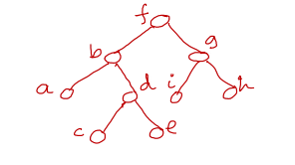
Construct a Binary Tree from Preorder & Inorder
Preoder: f → b → a → d → c → e → g → i → h
Inorder: a → b → c → d → e → f → i → g → h

Slide 20
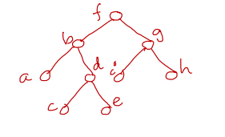
Construct a Binary Tree from Postorder & Inorder
Postoder: a → c → e → d → b → i → h → g → f
Inorder: a → b → c → d → e → f → i → g → h

Slide 21
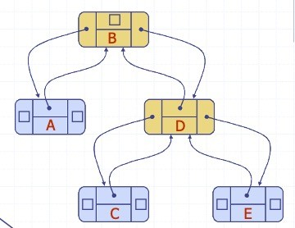
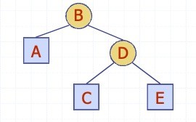
Linked Structure for Binary Trees
A node is represented by an object storing
  Element
  Parent node
  Left child node
  Right child node

Slide 22
Codes for Creation of Binary Trees
A binary tree can be created recursively. The program will work as follow:
Read a data in x.
Allocate memory for a new node and store the address in pointer p.
Store the data x in the node p.
Recursively create the left subtree of p and make it the left child of p.
Recursively create the right subtree of p and make it the right child of p.

Slide 23
Codes for Creation of Binary Trees
#include<stdio.h>
typedef struct TreeNode {
struct TreeNode *left;
int data;
struct TreeNode *right;
} TreeNode;

Slide 24
Codes for Creation of Binary Trees
TreeNode * createBinaryTree( ){
TreeNode *p;
int x;
printf("Enter data(-1 for no data): ");
scanf("%d", &x);
if(x == -1) return NULL;
//create current node
p = (TreeNode*) malloc(sizeof(TreeNode));
p->data = x;
//recursively create left and right subtree
printf("Enter left child of %d: \n", x);
p->left = createBinaryTree ( );
printf("Enter right child of %d: \n",x);
p->right = createBinaryTree ();
return p; }

Slide 25
Codes for Creation of Binary Tree Traversal
void preorder(TreeNode *t) {
if(t != NULL) {
printf("\n%d", t->data);
preorder(t->left);
preorder(t->right);
}
}
int main() {
TreeNode *root;
root = createBinaryTree ( );
printf("\nThe preorder traversal of tree is: \n");
preorder(root);
}

